Slide 1
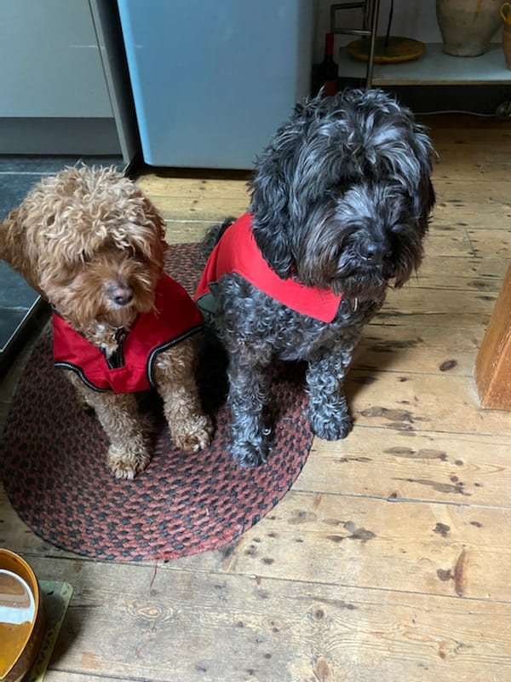

Being prepared for
Harassment and abuse
TRANS STUDIES RESEARCH
amidst CULTURE WARS
Ruth Pearce
Website: RUTHPEARCE.NET
Email: Ruth.Pearce@Glasgow.ac.uk
Instagram: @notrightruth

Slide 2



Why is inclusive language important?
Findings from: Trans Pregnancy Project (2017-21) and Improving Trans Experiences of Maternity Services (2020-22)
Trans birth parents wrongly portrayed as unusual/exceptional (Pearce and White, 2019)
Lack of understanding and formal support from service providers (Riggs et al., 2020; 2021)
Only 42% of trans respondents in English survey were spoken to in a way that respected their gender all the time
(LGBT Foundation, 2022)
30% did not access NHS or private midwives during their pregnancy (LGBT Foundation, 2022)
Intersectional oppression:
  e.g. trans people of colour risk medical racism and transphobia (LGBT Foundation, 2022)

Slide 3
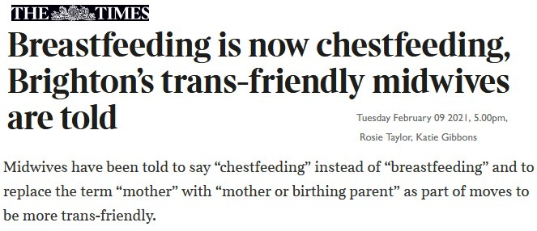
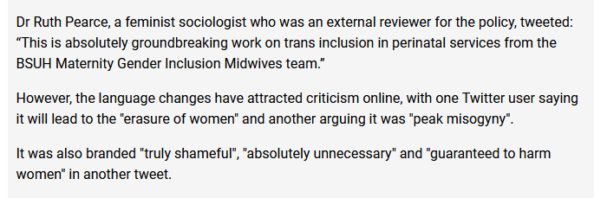

Slide 4
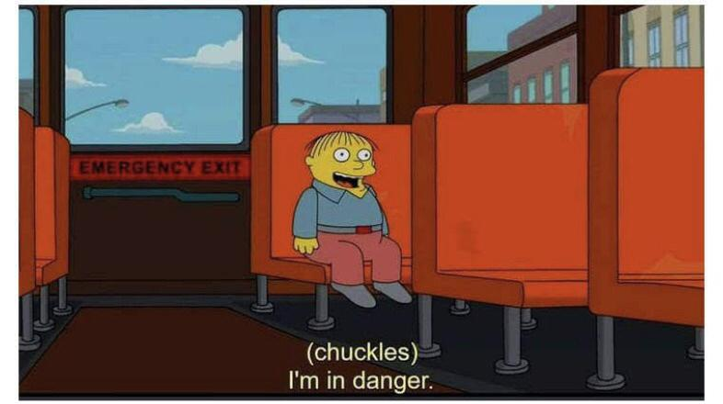

Slide 5

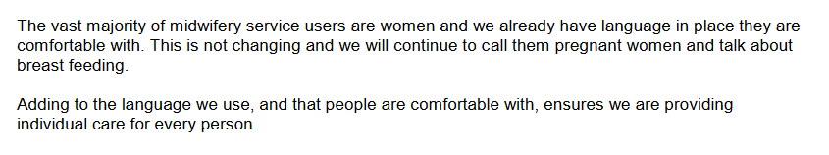

Slide 6
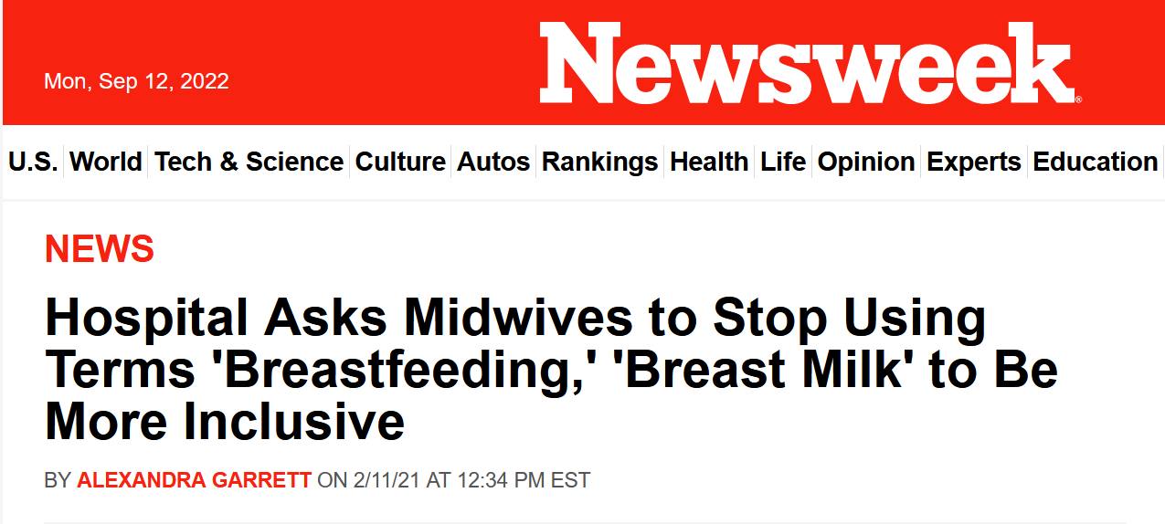
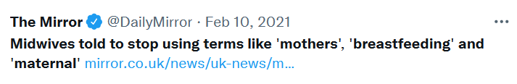
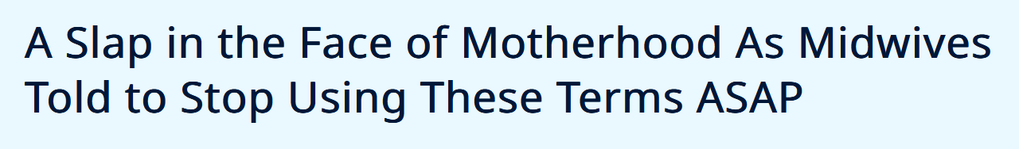
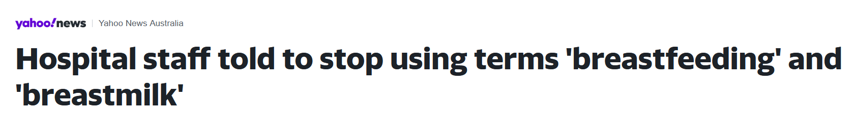
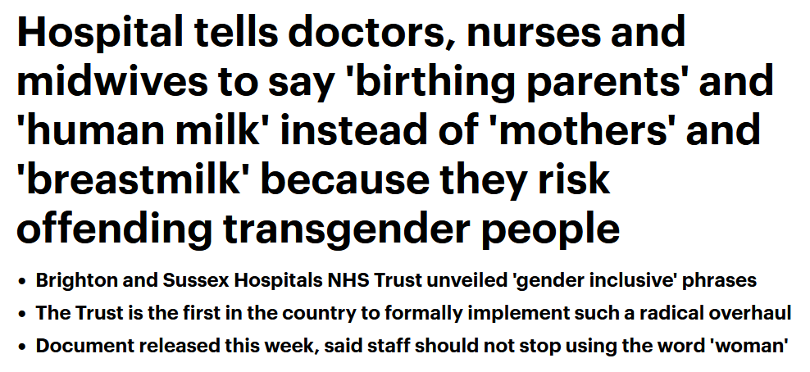
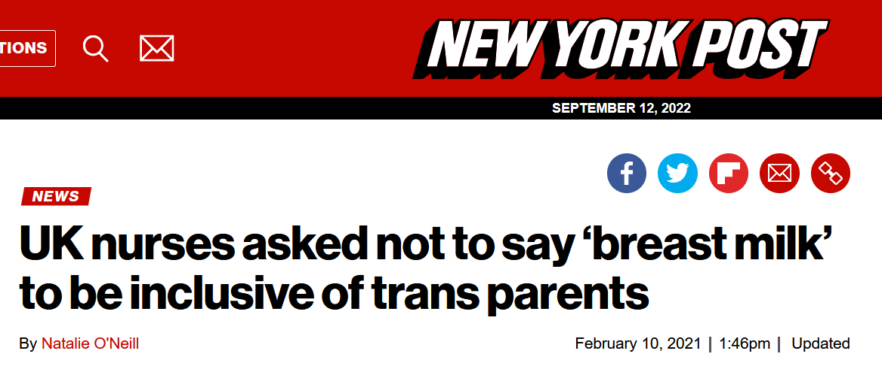

Slide 7
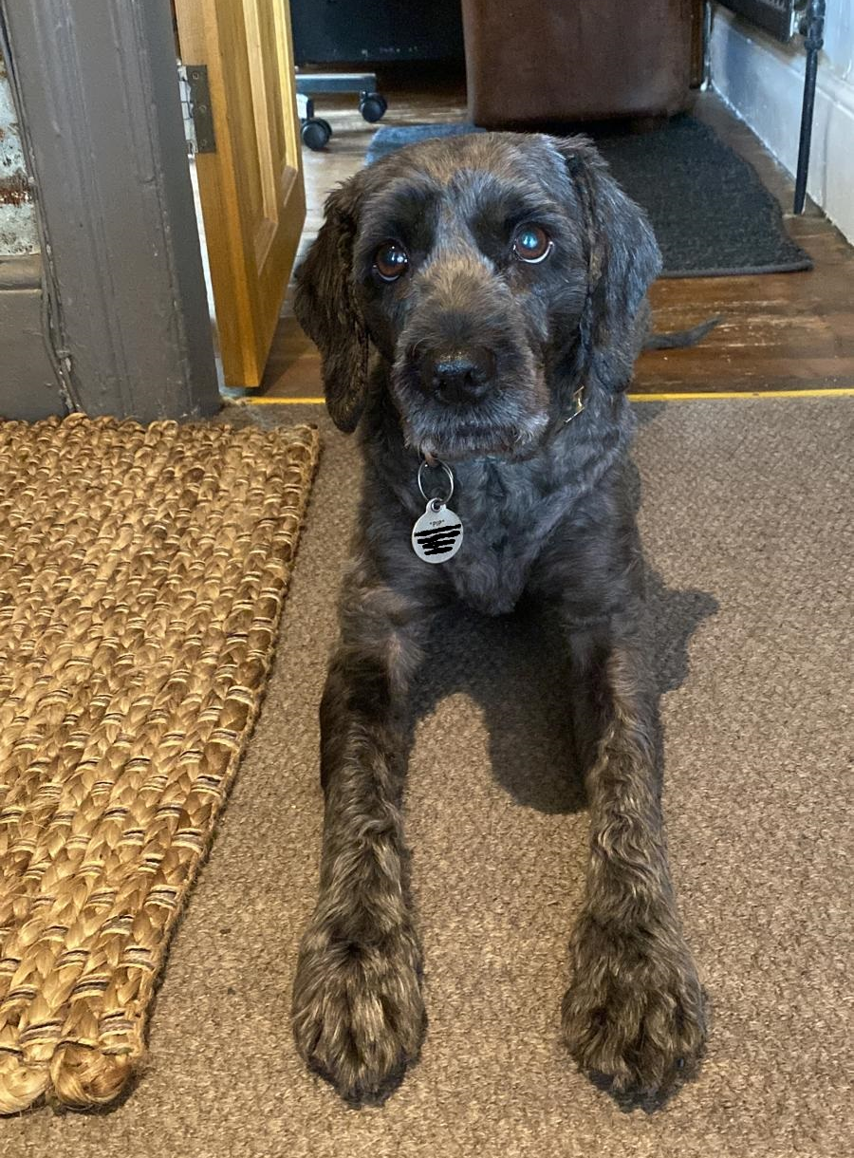
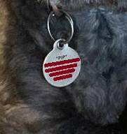
Backlash to the trans pregnancy project
Disinformation from media, politicians
Transphobic, sexist social media harassment
Mendacious Freedom of Information requests
Complaints about the project:
  to Head of School
  to Vice Chancellor
  to funder (ESRC)
Doxxing of project PI Sally Hines
Good old-fashioned analogue hate mail
Pip the dog – photo by Sally Hines

Slide 8
Survival as method
If you are a PI and/or working with more
oppressed colleagues…
Do your research in advance
  What are the areas of political contention?
  What harassment and abuse might your team face?
  What survival strategies are most effective?
Do not assume it will all be okay. Take some
responsibility for your colleagues’ survival.
Pearce, R. (2020) A methodology for the marginalised: Surviving oppression and traumatic fieldwork in the neoliberal academy. Sociology, 54(4), 806-824.

Slide 9

Pre-emptive comms engagement
Pre-prepared press statements
  Be ready to counter disinformation
  Simple key message, written for those who care about topic and are interested
Media and social media training
  Which platforms are you using? Why?
  Use available tools
  (e.g. blocking, limiting replies)
Briefing managers, HR, comms officers
  Explain why you and/or colleagues are at risk
  Managers/HR/comms take responsibility
  Prepare for ‘free speech’ complaints

Slide 10
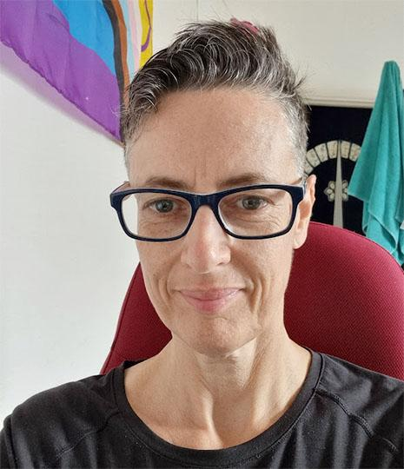
Critical bureaucracy
How to align an ethic of social justice with inequitable models of policy and practice? (Carlile, 2012)
‘multiple incremental decisions in the delivery of policy’
‘study up’ on the techniques and mobilising metaphors of power
What do people with power want?
What power do we have?
What demands can we make?

Slide 11
Critical bureaucracy: some ideas
Collective survival
  Networks for researchers with similar experiences
    e.g. Emotionally Demanding Research Network Scotland
  Demand funding for events and networks
  Collaborate on research and writing – don’t be alone!
Attend to mental health
  If you need help: seek help
  If you are writing a grant: budget for counselling/therapy/mentorship – and time off
  If you are a supervisor or mentor: prepare students and/or mentees for distressing fieldwork
Oppose casualisation
  Don’t create shit jobs
Strategic comms
Universities tend to like publicity. What protection can they provide in return?

Slide 12
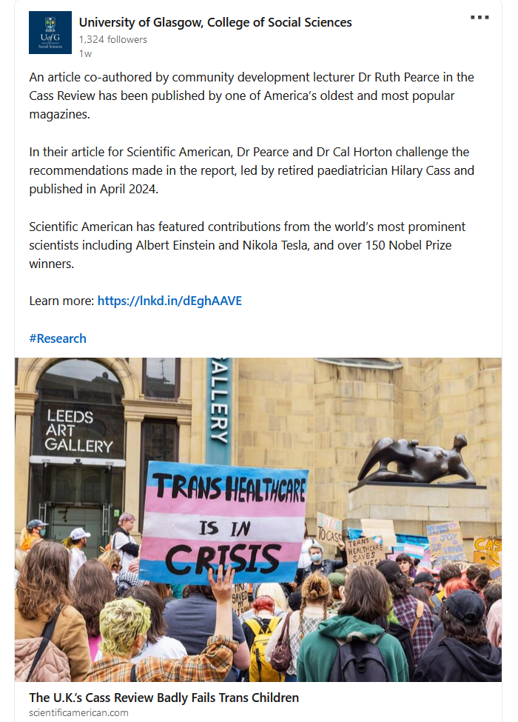
Comms strategies
Recent actions taken by the University of Glasgow
communications team
  Strategic social media
  (e.g. sharing on LinkedIn, not Twitter)
  Checking press release with me
  Monitoring social media commentary on my work - so I don’t have to
  Removing my contact details from the university website
  Filtering media requests
  Security monitoring of my office around key publication dates
A proactive rather than reactive approach

Slide 13
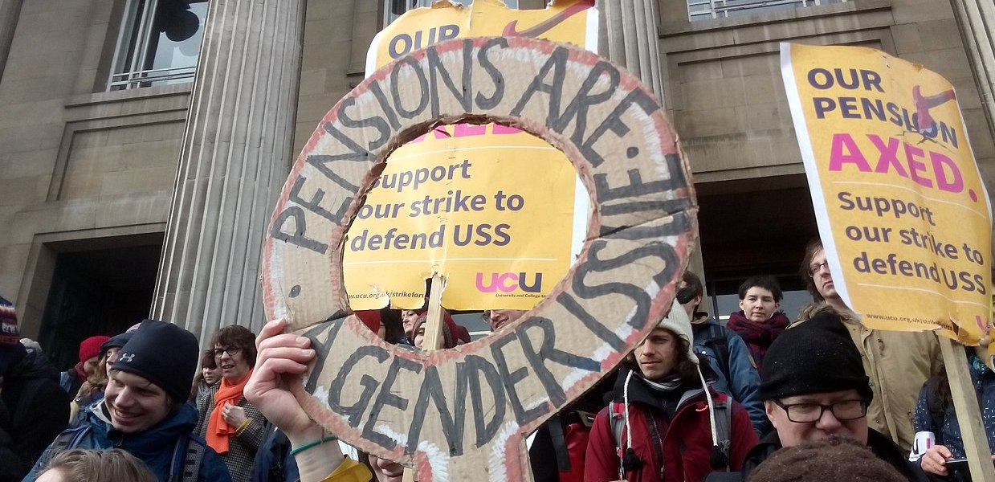
And finally… Fight the system!
  ‘Who has your back and whose back do you have?’ (Collins, 2016)

