Slide 1


Proposed changes to the availability of puberty blockers
Expert comments on evidence, impact, and safety
Dr Ruth Pearce
ruth.pearce@glasgow.ac.uk

Slide 2
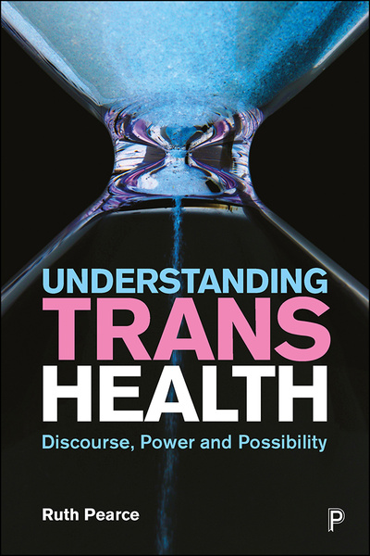
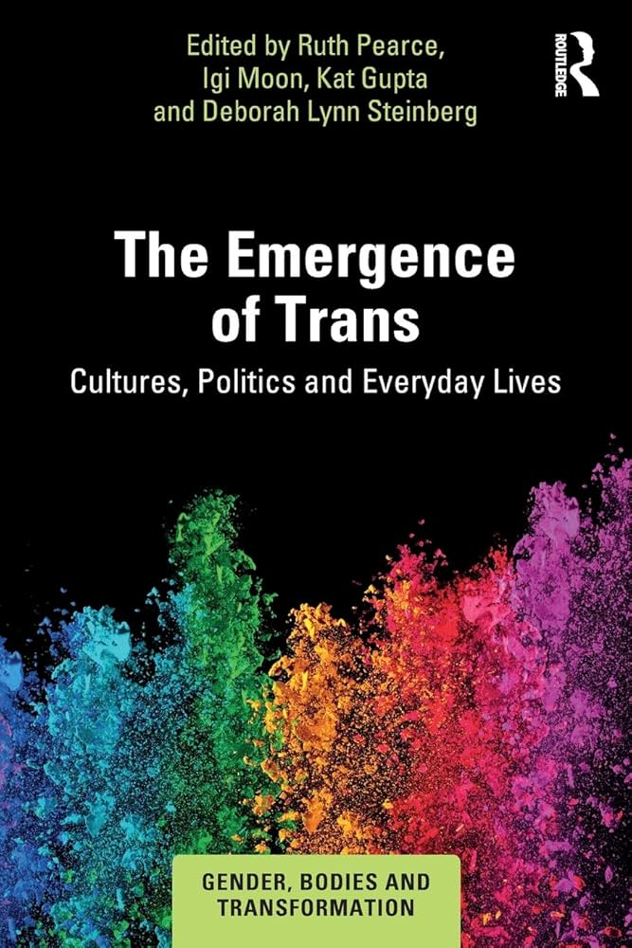
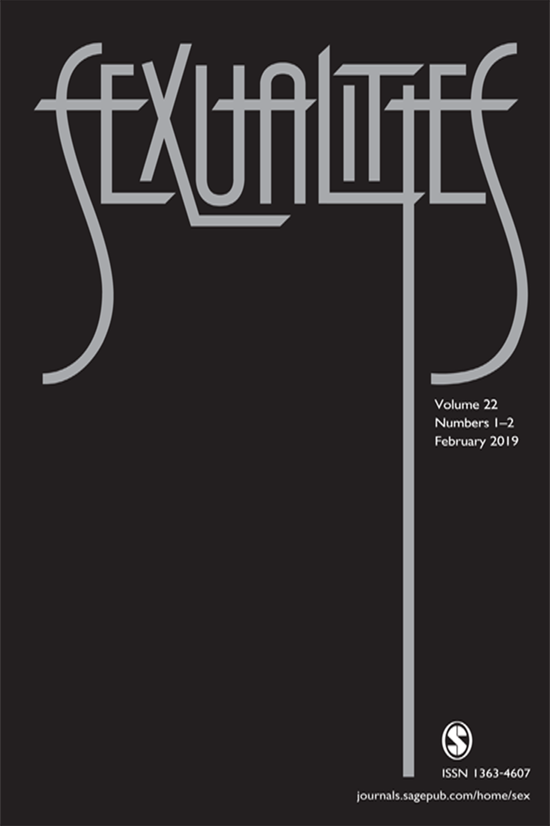
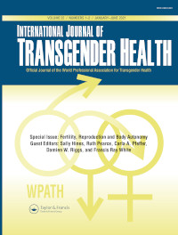
Research background
Interdisciplinary social scientist
Peer-reviewed work on trans healthcare
  Gender clinics, fertility and family planning, children and adolescents, social determinants of health
  Sociology, psychology, psychiatry, epidemiology, feminist and queer studies journals and books

Slide 3
GnRH agonist ban: my arguments today
Ban based on flawed evidence
Ban is unsafe
The UK is an international outlier

Slide 4
Flawed evidence for ban on GnRH agonists
Rationale based primarily on the Cass Review:
  Findings on GnRH agonists widely rejected by area experts
    e.g. WPATH, Endocrine Society, British Association of Gender Identity Specialists, peer-reviewed articles in International Journal of Transgender Health, forthcoming article in Lancet Regional Health Europe
  Social and qualitative literatures almost entirely ignored
    e.g. Davy (2011), Carlile (2020, 2021), Horton (2023), Kennedy (2010, 2022), Mikulak (2021, 2022),
    Pearce (2018)
    NIHR funded project “Identifying the health and care needs of young trans and gender diverse people” (2018-2022)
  Broad issues with unevidenced statements and inaccurate claims
    “During the lifetime of the Review [2020-24] the term trans has moved from being a quite narrow definition to being applied as an umbrella term to a broader spectrum of gender diversity. This clearly has implications for conceptualisations of detransition” (p.126)
    “For many centuries transgender people have been predominantly trans females, commonly presenting in adulthood” (p.114)

Slide 5
Flawed evidence for ban on GnRH agonists
Rationale based primarily on the Cass Review:
  Benefits indicated, but better evidence required
    van der Miesen et al. (2020): trans adolescents on puberty suppression have improved psychological functioning, equivalent to cis peers (rated high-quality by Cass team)
    Costa et al. (2015): puberty suppression associated with improved psychosocial functioning
    de Vries et al. (2011): puberty suppression contributes to general functioning
  Evidence base expanding and improving
    17 new studies on puberty suppression published between 2017 and 2023 (Bragge et al., 2024)
    Unpublished longitudinal studies indicate equivalent mental health outcomes to cis peers,
    high levels of satisfaction, low levels of regret (e.g. Kuper et al., 2024; Olsen-Kennedy et al., 2024)

Slide 6
Flawed evidence for ban on GnRH agonists
Rationale based primarily on the Cass Review:
  Possible risk: bone mineral density
    NICE review (2020): observed reductions within one standard deviation of normal
    Ramos (2021): addition of HRT tends to re-establish bone mineral density
    van der Loos et al (2023): z scores caught up with pre-treatment levels following HRT, with exception of trans woman participants with suspected low oestradiol concentrations
  Possible risk: reduced psychosocial functioning and cognitive development
    Claims in Cass Review based on conjecture, rather than evidence (see e.g. Grijseels, 2024)
  Possible risk: fertility
    Risk depends on Tanner Stage – also question of consent
    GnRH agonists (and HRT) are not contraceptives! (Vincent, 2018)

Slide 7
Flawed evidence for ban on GnRH agonists
Rationale based primarily on the Cass Review:
  Qualitative evidence ignored or missed by Cass Review (examples)
    Horton (2024):
      Key themes: pre-pubertal anxiety, difficulties accessing blockers, experiences of relief and frustration on blockers
        Participant: “I’m very grateful that I managed to get on blockers at the kind of age that I did”
        Participant: “the positive of blockers isn’t necessarily what the blockers do, it’s more like, the kind of lack of negatives that comes with them”
    Carlile et al. (2021)
      Relevant themes: frustration with rigid medical pathways (e.g. blocker requirement prior to HRT),
      high-dose contraceptives used as alternative

Slide 8
Proposed ban is unsafe
Suicidality:
  Suicide ideation and suicide attempts already high among trans people in the UK
  (Mann et al., 2018)
  Lee et al. (2024) State-level anti-transgender laws increase past-year suicide attempts among transgender and non-binary young people in the USA, Nature Human Behaviour
    n= 61,240
    Statistically significant increase in reported suicide attempts following introduction of trans healthcare bans
    7-72% increase in past-year suicide attempts (dependent on age, US state etc)

Slide 9
Proposed ban is unsafe
Wider impact on young people and their families:
  Kennedy (2024) Children of Omelas; Effects of the UK Puberty Blocker Ban, pre-print
    Qualitative survey of parents of young trans children (n = 97)
    September 2024
    Themes:
      Extreme levels of distress among young people who did not have access to blockers prior to ban
      Relief among young people who have continued access to blockers
      Extreme distress and sense of betrayal among young people who lost access to blockers
      Increased sense of transphobia in wider society following announcement of temporary ban

Slide 10
Proposed ban is unsafe
Wider impact on young people and their families:
  Kennedy (2024) Children of Omelas; Effects of the UK Puberty Blocker Ban, pre-print
    Extreme levels of distress among young people who did not have access to blockers prior to ban
      “I have a child who has been suicidal, self-harming and has been unable to leave the house.”
      “once she found out blockers were banned she has withdrawn from spending time with friends, she is crying all the time”
    Relief among young people who have continued access to blockers
      “He no longer attempts suicide and goes to school again”
      “When she had her first blocker she felt relieved because she would no longer stop looking like herself […] Her OCD disappeared. She anxiety lessened. She thrived and could sleep alone.”
    Distress and sense of betrayal among young people who lost access to blockers
      Distraught. Devastated. Distressed. […]This deeply affected her trust in adults responsible for her care, and had a knock on effect on relationships with teachers, club leaders, the GP etc.”

Slide 11
Proposed ban is unsafe
Criminalisation, self-medication, and the black market:
  Existing high rates of self-medication and private care due to waiting lists, inflexible pathways (Pearce, 2018)
  Reduced trust in NHS specialist services (Kennedy, 2024)
  Risk of prosecution likely to deter young people, families, and carers from seeking support from GP or specialist NHS providers
  Throughout history, young trans people have found ways to obtain medication regardless of medico-legal landscape (see e.g. Gill-Peterson, 2018; Playdon, 2021)

Slide 12
The UK is an international outlier
USA
  WPATH Standards of Care v8 and Endocrine society recommend GnRH agonists
    Similar but larger evidence base, wider and more diverse range of expertise
Australia
  Evidence review commissioned by New South Wales Ministry of Health
    GnRH agonists reported to be “safe, effective and reversible” in expanded literature (Bragge et al., 2024)
  Service review commissioned by Queensland Minister of Health
    “effective care from referral to discharge” – treatment in line with international guidelines (Queensland Government, 2024)
Japan
  Society of Psychiatry and Neurology recommend continued use of GnRH agonists
    “WPATH 8th edition SOC is written based on a greater number of systematic reviews than the Cass Review.” (Society of Psychiatry and Neurology, 2024)

